Slide 1
Advance Care Planning for
People with Dementia
與認知障礙(失智)症患者預設照顧計劃
Dr Helen Chan RN PhD
Associate Professor

Slide 2




Dementia
Major Neurocognitive Disorder (5th edition of the Diagnostic and Statistical Manual of Mental Disorders (DSM-5), American Psychiatric Association, 2013)
                significant cognitive decline which interferes with complex attention, executive function, leaning and memory, language, perceptual-motor, and social cognition

Slide 3



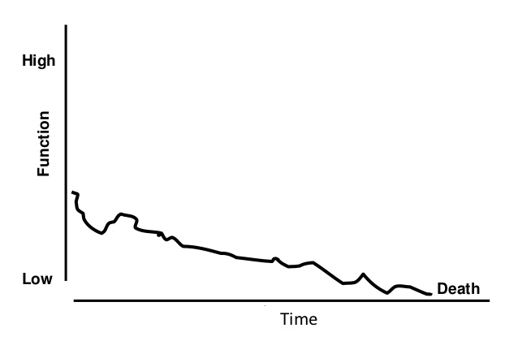
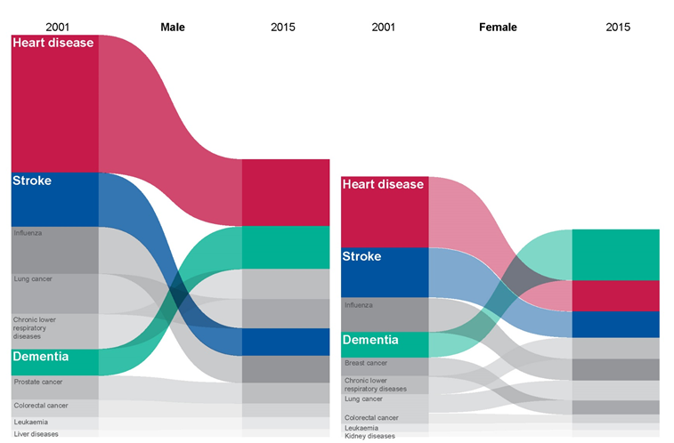

Dementia =
Terminal condition?
Credit Alzheimer's Association
survival rates ranging from 4 to 10 years
(Health Profile for England, 2017)

Slide 4
Use of life-sustaining treatment (維生治療) in advanced dementia in Taiwan
%
4 times higher than
cancer patients !
(Geriatrics & Gerontology International)

Slide 5
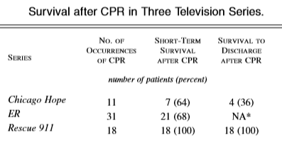
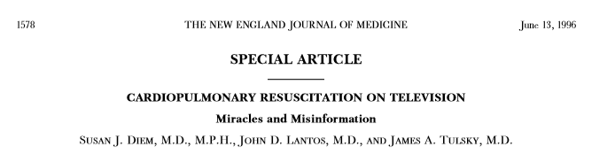
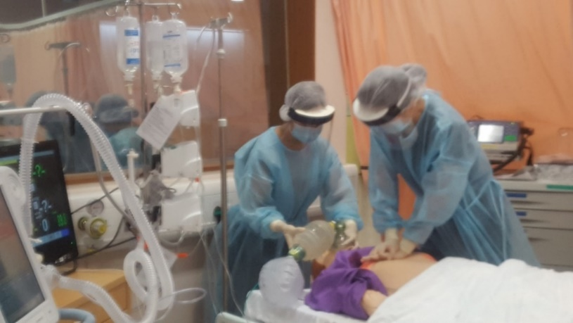
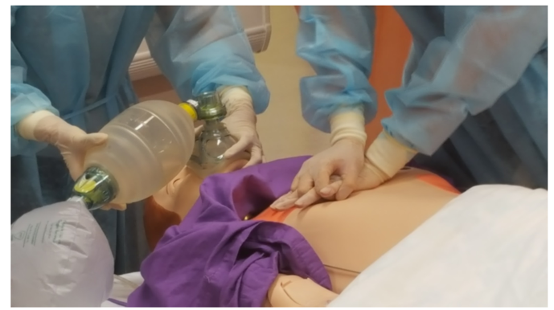
Treatment efficacy 治療效用
Overall survival rate 整體存活率: 23.8 – 44%
Survive to discharge 存活至出院: 7.6 – 17%
6-month condition: conscious (23%), brain damage (9%), persistent vegetative state (66%)
(Hospital Authority Guidelines on Do-Not-Attempt Cardiopulmonary Resuscitation (DNACPR), 2016)

Slide 6
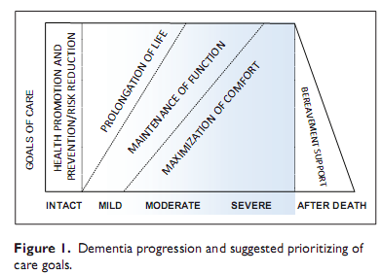
Goal of care?

Slide 7

Advance Care Planning (ACP)
預設照顧計劃
To enable individuals to reflect upon the meanings & consequences of serious illness scenarios, to define goals and preferences for future medical treatment & care, to discuss these goals & preferences with family & healthcare providers, & to record and review these preferences if appropriate.
(Lancet Oncology, 2017)
Person
個人
Family
家屬
Health care providers
醫護人員

Slide 8
Whose decisions?
Health professionals
Person
Family
?
My family members understand me. They know how to make the decision for me. 我的家人明白我, 他們會知道怎樣為我做決定.
I will leave my life into their hands. 我會交託到他們的手

Slide 9
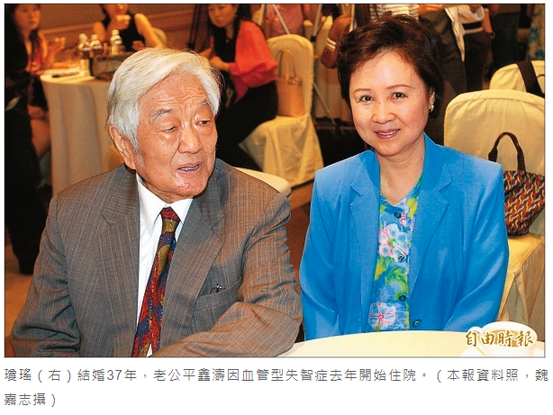
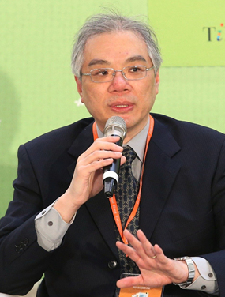
The son said, “My father is not critically ill (病危), he is just demented”
「對於您來說，父親得了失智症，不再記得您，就是「沒有靈魂的肉體」，就不值得活下去，但對我們來說，即使父親不記得我們了也沒有關係，只要他在自己的世界裡好好地活著就足夠了。他不記得我們，但我們對他的記憶還在…我們心裡都感到十分不忍」
平鑫濤因失智入院治療，
瓊瑤不忍他受插鼻胃管之苦。

Slide 10
Concordance between patients and family on EOL care wishes
病患者與家屬對晚期照顧意願的一致度
p=0.024*
p=0.034*
P<0.001***
p=0.018*
Chan, H.Y.L., Ng, J.S.C., Chan, K.S., Chan, L.N., Ko, P.S., Leung, D.Y.P., Lee, I.F.K., Lee, D.T.F., Chan, C.W.H. (2018). Effects of a nurse-led post-discharge advance care planning programme for community-dwelling patients nearing the end of life and their family members: A randomised controlled trial. International Journal of Nursing Studies, 87, 26-33.

Slide 11
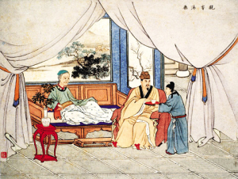

Symbolic meaning of feeding
「割股療親」
In Sung Dynasty…
Yu fed his sick father with flesh from his son and his own body. Such treatment was ineffective, and his father died. Soon after, Yu and his son also died from exhaustion.
Despite this tragedy, their act was highly commended by the emperor and by their neighbours. A monument was eventually built to commemorate Yu’s unconditional love and devotion.
Chan HYL, Wong KKY. Enteral feeding in palliative care: cultural aspects and beyond. Handbook of Nutrition and Diet in Palliative care (2nd ed.) (in press)
_{孝义坊 （广东省中山市牌坊名)}
_{《香山县志》卷十三}

Slide 12

When to start ACP?
Holding onto life
Weighing benefits
Planning ahead
Deferral
Avoiding
Chan, H.Y.L. & Pang, S.M.C. (2011). Readiness of Chinese frail old age home residents to end-of-life care decision making. Journal of Clinical Nursing, 20, 1454-1461.

Slide 13
Challenges of conducting ACP in people with dementia – HCP perspectives
Lack of knowledge about dementia/ACP
Questionable mental capacity
Lack of training/skills
Organizational barriers
(Yeung & Chan)

Slide 14
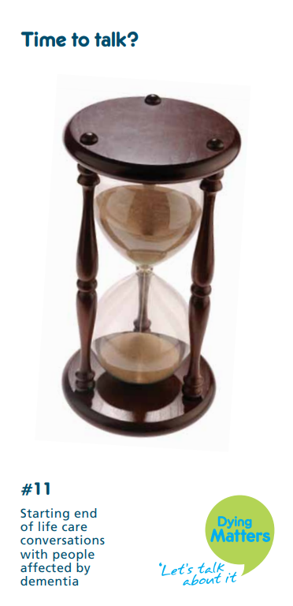
Roles of health and social care professionals
醫社角色
Provide your clients with fair access to ACP opportunity
Don’t leave people to flounder and scratch around for information

Slide 15
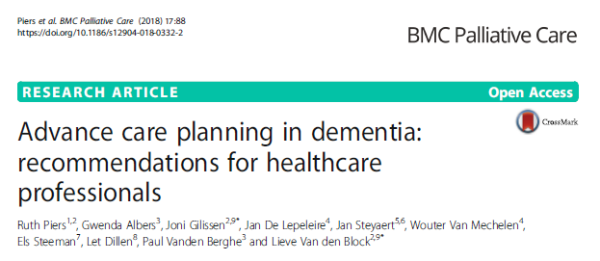
Recommendations for healthcare professionals
Initiation of ACP,
Evaluation of mental capacity,
Holding ACP conversations,
The role and importance of those close to the person with dementia,
ACP when it is difficult or no longer possible to communicate verbally,
Documentation of wishes and preferences, including information transfer,
End-of-life decision-making &
Preconditions for optimal implementation

Slide 16
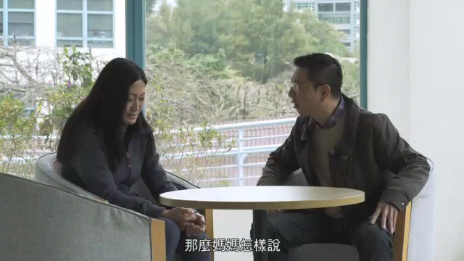


Audiovisual resources

Slide 17

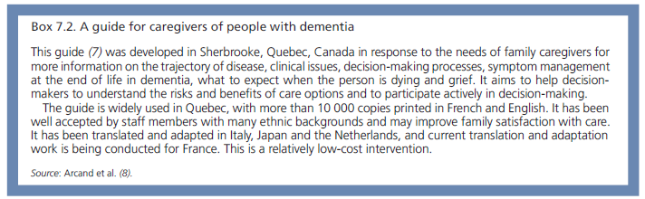
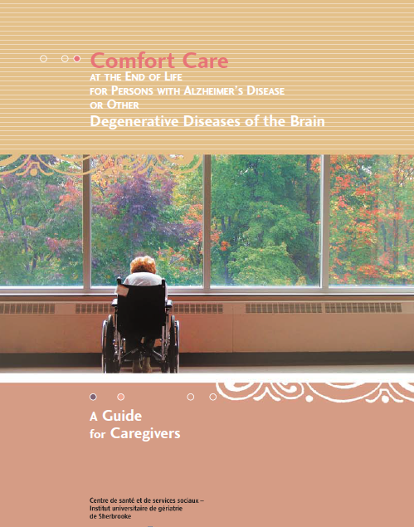
Palliative care for older people with dementia

Slide 18
ACP is …
an ongoing process.
an empowerment process.
to reduce anxiety and avoid conflicts.
one of the duties of health care providers.
everyone’s business.

Slide 19
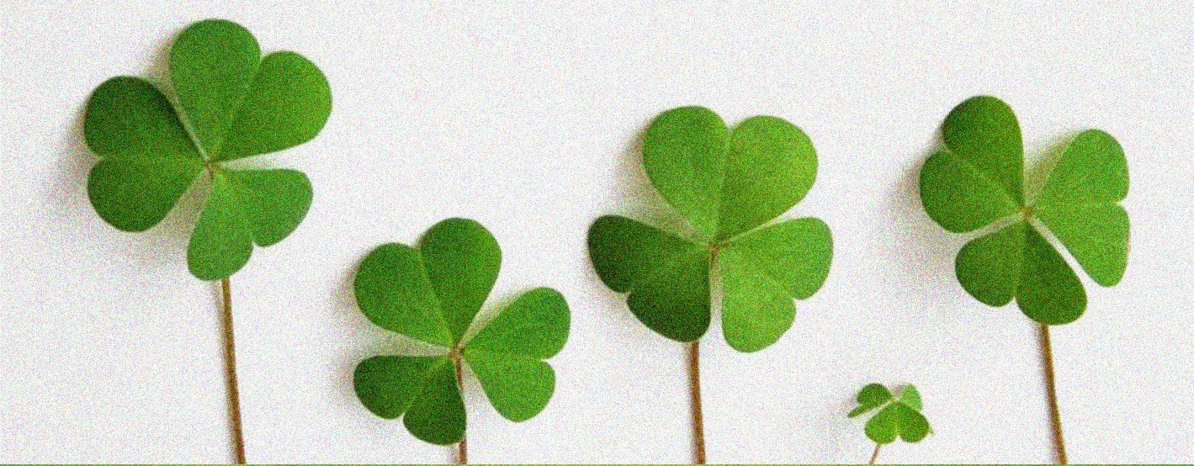
Thank you! helencyl@cuhk.edu.hk

